Slide 1
A.R.I.A: Air Pollutants Monitoring Using UAVs
Gian Marco Bolla, Marco Casagrande, Antonio Comazzetto, Riccardo Dal Moro, Matteo Destro, Edoardo Fantin, Students in Aerospace Engineering, University of Padova, Italy
Giacomo Colombatti, Alessio Aboudan, CISAS G. Colombo Center for Studies and Activities for Space, University of Padova, Italy
Enrico C. Lorenzini, Department of Industrial Engineering, University of Padova, Italy

Slide 2
Index
What is the A.R.I.A Project ?
Which sensors do we choose ?
Which UAVs do we choose ?
Preliminary hardware configuration
Future developments

Slide 3
What is the A.R.I.A Project ?
SUBSECTION 1

Slide 4
Hands-on Student Project
A.R.I.A
Analisi
Monitoring
Air
Atmosferici
Using UAVs
Inquinanti
Pollutants
Con apR di

Slide 5
Project Description
Object
Measure vertical gradients of Air Pollutants.
UAVs
Use UAVs to transport the sensors at the desired altitudes and locations.
Create a swarm formation to measure the polluted-air distribution.
Sensor
Use low cost sensors.
Choose the sensor as a function of the most polluted-air parameters.
Data
Collect and analize data from sensors to produce a 3D distribution (vertical gradients and horizontal locations) of Air Pollutants over a limited area

Slide 6
Which sensors DO we choose ?
SUBSECTION 2

Slide 7
Which sensors do we choose ? Chemical species targeted
Major Air Pollutants
CO
NO_{x}
O₃
PM
Pb
Carbon Monixide
Nitrogen Monoxide
Nitrogen Dioxide
…
Ozone
Sulfur Dioxide
SO₂
Particulate Matter
Lead
VOCs
Volatile Organic Compounds

Slide 8
Which sensors do we choose ? Sensors and Hardware

Slide 9
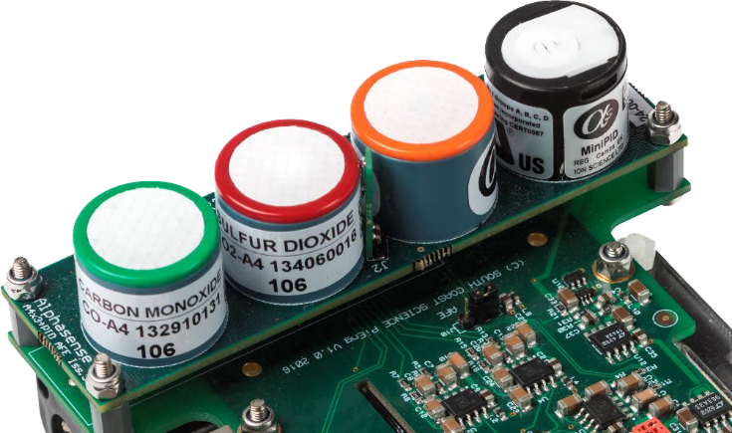
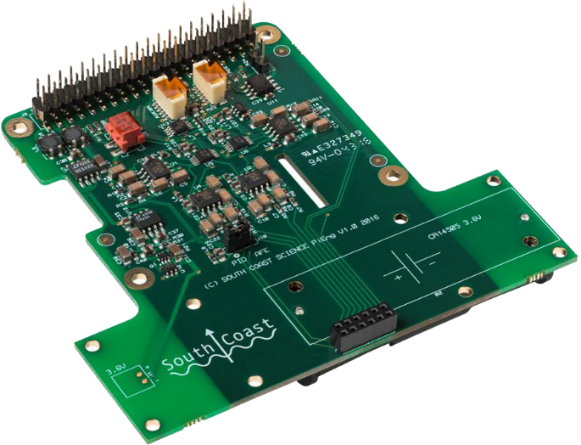
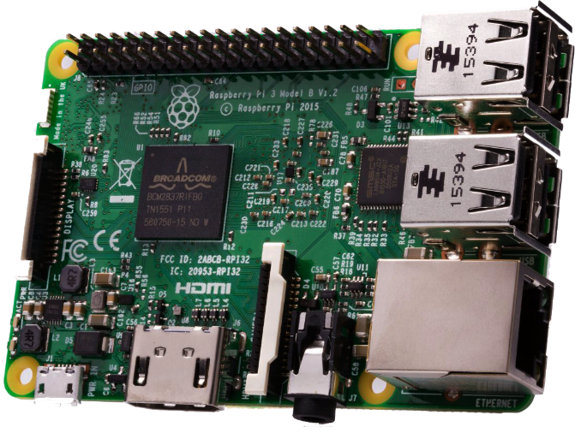
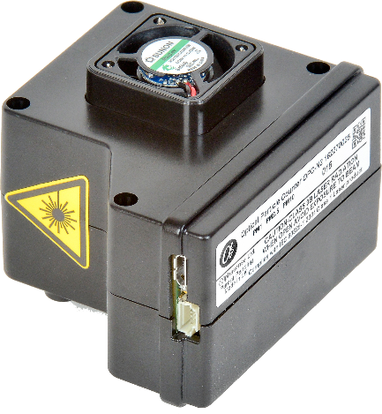
Which sensors we choose ? Sensors and Hardware
Substance | Weight [g] | Range
CO | < 6 | 500 ppm
NO | < 6 | 20 ppm
NO₂ | < 6 | 20 ppm
VOCs | < 8 | 50 ppm (isobutylene)
PM | < 105 | 0,38 to 17 μm sph. eq. size

Slide 10
Which uavs DO we choose ?
SUBSECTION 3

Slide 11
Which UAVs do we choose ?
Quadcopter
Autonomy
Safety
PayLoad Transport
Small System
Characteristic of flying formation

Slide 12




Which UAVs do we choose ? Swarm formation & control
Second Step
First Step
10m
Ground Control
10m
5m

Slide 13
Hardware configuration
SUBSECTION 4

Slide 14
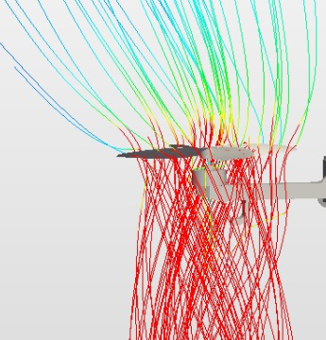
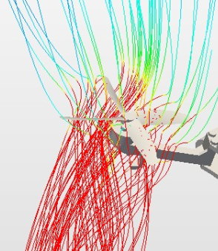
Hardware configuration CFD Study
Examples of CFD analysis
These images report the flow generated by a rotor.
Fluid dynamic study of an entire quadcopter.
Fluid dynamic study of the system including sensors
Static and dinamic fluid dynamic study

Slide 15
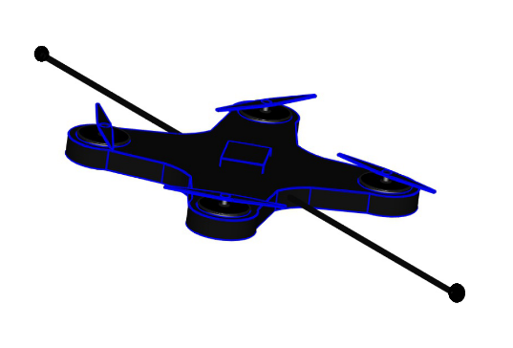
Hardware configuration Possible configurations
Sensor position
On UAV
Weight
Stability
On Boom
Turbolence
Problem
Possible Solution
Challenges
Air Pollutants Sensor

Slide 16
Future developments
SUBSECTION 5

Slide 17
Future development
Automate Formation
Reduce System Dimension
Add Chemical Species

Slide 18
Questions?
THANKS FOR THE ATTENTION.

